Slide 1
The diabetic foot and lower limb
How does it affect you?
29 June 2015
Alan Postlethwaite
HS Foot Care Services
www.hsfcs.co.uk

Slide 2
Agenda
What is diabetes
Statistics
Its affect on you as practitioners
Reduction of risk
How the body works in diabetes
Practical steps
Summary

Slide 3
But first …….
You guessed it
Are we all on the same page ?
Notes:
----- Meeting Notes (09/04/2013 15:37) -----
The foot is relly complex

Slide 4
What is diabetes?
Diabetes is the 3rd largest cause of death in the UK and increasing rates does not bode well.
1996 to 2012 diagnosis increased from 1.4 m to 2.9 m
Globally a diabetic amputation every 30 secs!

Slide 5
General diabetes facts
The full medical name for diabetes is Diabetes Mellitus
There are 3 main types of diabetes: type 1, type 2 and gestational diabetes
Type 1 diabetes is sometimes called juvenile diabetes or insulin-dependent diabetes
Type 1 diabetes is managed using insulin injections or an insulin pump
90% of people with diabetes have type 2 diabetes
Type 2 diabetes used to be called non-insulin dependent diabetes
Type 2 diabetes is managed by diet, exercise and sometimes medication and insulin
Diabetes.co.uk
Notes:
I wonder how many here are diagnosed?
You don’t need to but just a quick show of hands

Slide 6
Prevalence
Diabetes UK March 2013

Slide 7
Prevalence
By 2025 estimated that 5m people will have diabetes in the UK.
Most of these cases will be Type 2 diabetes
Why?

Slide 8
Why?
Because of ageing population
Rapidly rising numbers of overweight and obese people.
????

Slide 9
Diabetes worldwide
Diabetes affects around 370 million adults worldwide
The global diabetes rate is expected to grow to 552 million by 2030, or 9.9% of the adult population
Diabetes is rapidly increasing in low- and middle-income countries
China has the largest diabetes population, with 90 million diabetes sufferers, followed by India (61.3m) and the USA (23.7m)
Africa is projected to see the largest growth in diabetes prevalence between now and 2030, with rates forecast to rise from 14.7 million to 28 million (90% increase)

Slide 10
What should we do?
We need to increase awareness of the risks;
Bring about wholesale changes in lifestyle;
Improve self-management among people with diabetes;
Improve access to integrated diabetes care services.

Slide 11
How does it affect you?
What part of the body shows first signs?
What are those signs?
Whose problem is it?
Whose responsibility is it?
Notes:
----- Meeting Notes (08/05/2014 16:32) -----
Your thoughts?

Slide 12
Signs
Lack of sensation
Dry skin
Cold feet
Bulging veins
Hairless legs
Thirst
Frequent urination
Unusual hunger
Dry mouth
Weight gain or loss
Headaches
Blurred vision
Impaired healing
Sexual dysfunction
Damaged blood vessels
Decreased sensation
Erectile dysfunction
Vaginal dryness

Slide 13
How does it affect you?
What part of the body shows first signs?
What are those signs?
Whose problem is it?
Whose responsibility is it?
Notes:
It’s not your problem but it is your responsibility!
Routine checks may prevent damage – if in doubt – check it out!

Slide 14
Understanding can help!
The ‘At Risk’ foot

Slide 15
What makes a ‘foot at risk’?
A loss of tissue viability, usually by an intrinsic cause.
Tissues unable to withstand environmental stress
Healing may be delayed or incomplete.
Severely compromised may lead to stasis, deterioration and the spread of infection.
Notes:
Stasis – stoppage or reduction in flow of blood

Slide 16
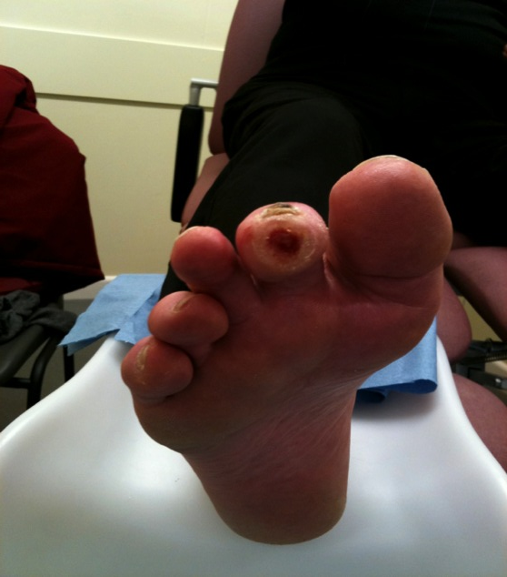
Factors contributing to an ‘at risk’ foot
Trauma – damage (blister/fissure/cut)
Ulceration
Infection (superficial – soft tissue)
Infection (deep - osteomyelitis)
Gangrene and necrosis
Septicaemia.
Amputation

Slide 17
Factors involved in an ‘at risk’ status
Vascular
- ischaemia - venous stasis
Neurological
Neoplasia
Infections
Immuno-compromised
Trauma
Foot deformity
Ageing
Notes:
Neoplasia – abnormal growth of cells – tumour
Reduced immunity – drugs, cancer , AIDs, therapy

Slide 18
Complications may be broadly categorised as follows
Macrovascular disease (large vessel)
Miocardial Infarction (MI)
Cerebrovascular Accident (CVA)
Amputation
Microvascular disease (small vessel)
eye, kidney and nerve damage
Diabetic eye disease
cataracts, glaucoma
Diabetic foot disease
infection
neuropathy
ischaemia
ulceration
Notes:
MI Miocardial infarction – heart attack
CVA cerebrovascular accident (stroke)
TIA transient ischaemic attack (mini stroke) – symptoms short lived 24 hours

Slide 19
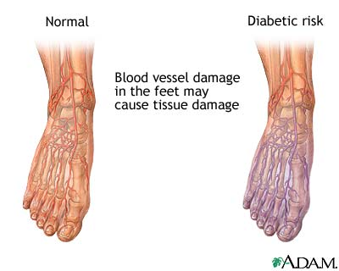
Circulation

Slide 20
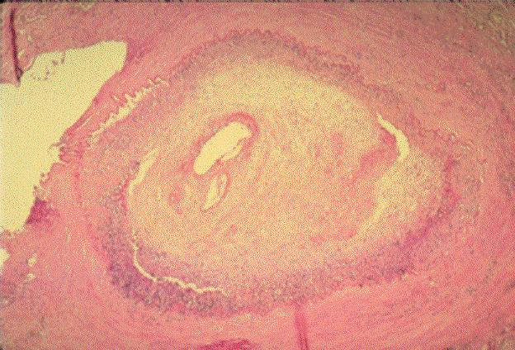
Small artery atherosclerosis
The Dorsalis Pedis vessel almost occluded by a plaque
Notes:
Likely medication – Simvastatin
Side effects? Tingling / painful legs

Slide 21
Foot ulcers
In diabetics, the greatest predictor of ulceration is a history of previous ulceration
(Abbot et al 2002)
Notes:
So what predsiposes Ulcers?

Slide 22
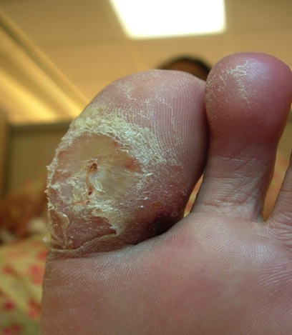
Signs of high pressure areas
Deformity
Redness
Callus
Corns
Blisters
Abnormal pressures
Increased shear and friction
Callosities

Slide 23
Most frequent cause of an ulcer
Ill-fitting shoes
Even in patients with "pure" ischaemic ulcers
Therefore, the shoes should be examined meticulously in all patients

Slide 24
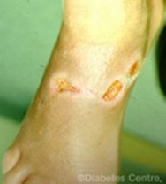
Shoe trauma
Blistering caused by new bespoke shoes
Neuropathic patient
Charcot deformity
Neuropathic ulcers caused by tight shoe straps

Slide 25
DM?
What part of the body is responsible?
What affects insulin production?
How is it measured ?
What is HbA1c?

Slide 26
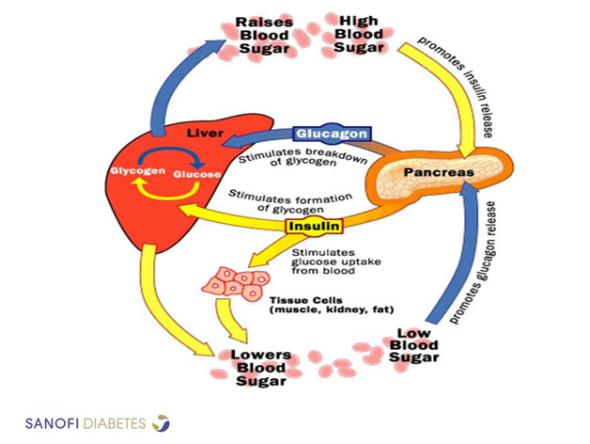
Insulin cycle

Slide 27
How insulin works?
What part of the body is responsible?
What affects insulin production?
What is measured ?
What is HbA1c?

Slide 28
HbA1c
HbA1c reflects blood glucose levels over the last 2-3 months – why?
Glucose in the blood binds irreversibly with Hb forming HbA1c (Glycated haemoglobin) this then circulates for the lifespan of the erythrocyte
The Diabetes Control & Complications Trial (DCCT) in Type 1 diabetes and the UK Prospective Diabetes Study (UKPDS) in Type 2 diabetes showed that the risk of microvascular & macrovascular complications increases as HbA1c increases.
HbA1c thus gives a measure of morbidity and prognosis.

Slide 29
HbA1c targets
HbA1c targets | Mmol/mol | %
Non-diabetics | 20 - 41 mmol/mol | 4% - 5.9%
Diabetics | 48 mmol/mol | 6.5%
Diabetics at higher risk of hypoglycemia | 59 mmol/mol | 7.5%
HbA1c levels between 5.7% and 6.4% indicate increased risk of diabetes (prediabetes).
Notes:
----- Meeting Notes (19/04/2015 11:22) -----
In the USA measurement is mg/dl not what we use in the UK

Slide 30
Your role as practitioner
Prevention of tissue damage?
Heal existing foot lesions
Maintain and monitor foot health
Educate and advise
Refer on ….?

Slide 31
Assessing the diabetic foot
Simple assessment – search for 8 clinical factors
Simple inspection
Palpation
Sensory testing

Slide 32
Why do we assess?
To identify feet which may be at risk
To assess the level of complications
To manage such patients and their complications
hoW do we assess?.........
History taking!!
Neurological examination – sensory system / motor system

Slide 33
History taking
Symptoms?
Duration
Site
Radiation
Quality of pain
Frequency of pain
Time of onset
Associated features
Precipitating / relieving factors
Hereditary factors / family history
Medical history
Social history
Treatment history / medication
Notes:
Medicines DM Ramapril, Losartan, Gliclazide Metformin
Biguanides – Metformin – improve bodies sensitivity to insulin – prevent liver from producing glucose
Sulphonylureas – Gliclazide – increase's amount of insulin produced (beats the pancreas to death)

Slide 34
8 Clinical factors in assessment
Neuropathy
Ischaemia
Deformity
Callus
Swelling
Skin breakdown
Infection
Necrosis
Prof. Michael Edmonds (Kings College –London) Managing the Diabetic Foot 2006
Notes:
Neuropathy most common complication of diabetes
50% of all diabetic patients – tingling, numbness

Slide 35
Peripheral neuropathy
Can affect:
Sensory Motor Autonomic
Sensory | Motor | Autonomic
Light touch, vibration, temperature, pain reduced. Pins & needles, numbness Painful neuropathy may be experienced | Muscle weakness Diminished reflexes (AT) Balance and proprioception reduced Claw toes, prominent met heads, wasted intrinsic muscles | Glandular secretion Postural hypotension Urinary and sexual function Digestive tract Signs of hypoglycaemia masked
Notes:
Classic motor sign – High medial longitudinal arch

Slide 36
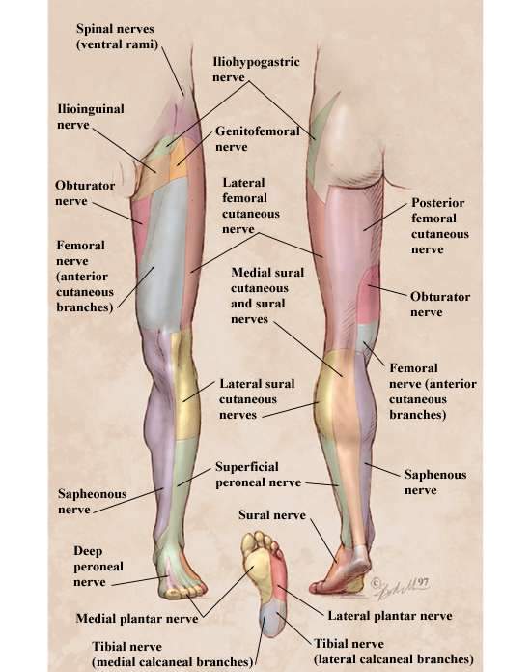
Nerve structure
Notes:
Anatomy Anatomy Anatomy

Slide 37
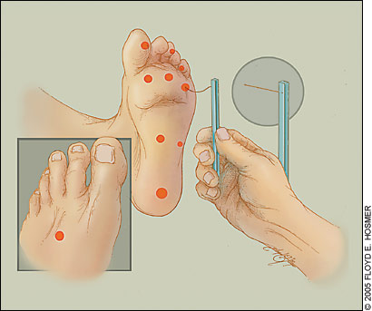
Testing for sensory neuropathy
Semmes Weinstein Monofilament 10g
Sharp/blunt
Vibration perception 128Hz
Hot/cold
Proprioception
Two point discrimination
Notes:
How many points do we test?
What nerves are we checking on the dorsal surface in the 2nd/3rd space? Deep common peroneal
And on the lateral border of the foot? Sural

Slide 38
The ‘Protective Threshold’
Inability to perceive the 10 g Semmes-Weinstein monofilament or the 128 Hz tuning fork indicates a times seven risk of ulceration in the next three years
(Boulton et al 1995)

Slide 39
What does a typical neuropathic foot look & feel like?
Features?

Slide 40
What does a typical neuropathic foot look & feel like?
Anhydrotic skin
Intrinsic muscle wasting
Clawing & retraction of toes.
Bounding pulses
Prominent dorsal venous arch
Very warm to touch – autonomic
Numb

Slide 41
Painful Neuropathy
Nerve damage due to diabetes can present as insensate neuropathy (sensory loss) or painful neuropathy.
The majority of people have the insensate type, however some patients with diabetes suffer chronic, often distressing symptoms of pain, pins and needles or numbness in their feet.
Up to 10% of those affected will experience persistent neuropathic pain.

Slide 42
Painful Neuropathy
Burning, feeling like the feet are on fire
Stabbing like sharp knives
Freezing, like the feet are on ice, although they feel warm to touch
Lancinating, like electric shocks
Notes:
If the patient had sharp stabbing pains in the plantar heel area – what is your likely diagnosis? PF

Slide 43
Autonomic neuropathy
Sympathetic innervation to the periphery has degenerated
No vasoconstriction
Arteriovenous shunting
Engorged dorsal veins
Notes:
Sympathetic general action is to mobilize the body's nervous system fight-or-flight response. It is, however, constantly active at a basic level to maintain homeostasis
An arteriovenous fistula is an abnormal connection or passageway between an artery and a vein.
It may be congenital, surgically created for hemodialysis treatments
or acquired due to pathologic process, such as trauma or erosion of an arterial aneurysm.

Slide 44
Motor neuropathy
High medial longitudinal arch.
High pressure areas
Test dorsiflexion of foot
Foot drop – ???? which nerve & muscles responsible

Slide 45
Motor neuropathy
High medial longitudinal arch.
High pressure areas
Test dorsiflexion of foot
Foot drop – peroneal nerve & peroneal longus / brevis

Slide 46
Loss of Pain
What are the effects?

Slide 47
Loss of Pain
Inability to perceive pain means injury goes unnoticed.
Tissues are damaged and healing is impaired.
Ulcers arise and infection is likely to invade
If infection destroys enough tissue, or if infection occurs in deep tissue i.e bone and joint, then AMPUTATION often required

Slide 48
Clinical features of lower motor neurone disorders.
Muscle weakness: slight weakness (paresis) to full paralysis
Muscle wasting: in the distribution of the damaged nerve
Fasciculation: Involuntary contractions, or twitching of groups of muscle fibres – muscles usually atrophied or weak.
Hypotonia: Muscular tone is diminished
Trophic changes: Partly as a result of disuse, and partly as a result of vasomotor (autonomic) involvement. Brittle nails, cold, cyanosed, dry skin.

Slide 49
Neuropathic Ulceration
Painless
Deep
Forms over pressure areas
Apices, dorsum of toes, metatarsal heads, heel.
Hyperkeratosed edges
Macerated surround
High exudate, sloughy
Granulating base
Pulses present
Notes:
Deep Wet No Pain

Slide 50
“At risk” areas for ulceration

Slide 51
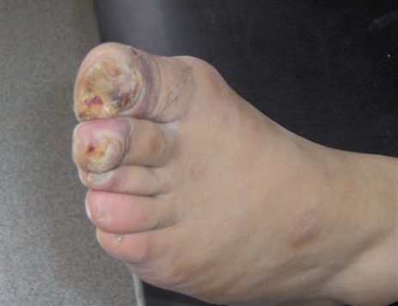
Neuropathic ulcers

Slide 52
The Charcot Foot
Notes:
What foot type is this?

Slide 53
Charcot’s Arthropathy
Charcot's arthropathy is a devastating condition affecting diabetic patients with peripheral neuropathy, resulting in a foot at risk for ulceration and amputation. Early diagnosis is important for the institution of appropriate treatment, which may help prevent disease progression and foot deformity.
(Jude and Boulton 2002)
Notes:
Approx 60% are in the tarsometatarsal joints - usually medial more than lateral

Slide 54
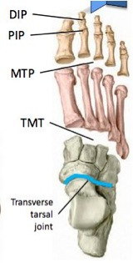
TarsoMetaTarsal Joint

Slide 55
ISCHAEMIA
DEFINITION
A pathophysiological state where tissues are under perfused with blood in relation to their metabolic needs

Slide 56
Ischaemic limb
Arterial supply to limb
Acute
Extrinsic - occlusion
Intrinsic - thrombosis
Chronic
develops slowly
gradual loss of tissue viability
Peripheral Vascular Disease
Transient
Raynauds phenomenon
Chilblains
Notes:
----- Meeting Notes (09/05/2014 23:22) -----
3 main headings

Slide 57
Peripheral vascular disease
Causes
Atherosclerosis
Fibro-fatty plaques
Arteriosclerosis (Monckeberg’s)
Ageing process
Accelerated in diabetes, usually bilateral and distal (arteries below knees)
(Thromboangitis Obliterans)
Smokers
Vasculitis of small arteries and arterioles
Gangrene of digits
Vasculitis
RA
SLE
Many others
Notes:
Monckeberg's arteriolosclerosis is characterized by focal calcification in the tunica media of small to medium-sized muscular arteries, without associated inflammation, largely sparing the intima and adventitia.
SLE Systemic Lupus Erythematosus white blood cels attack blood vessels

Slide 58
Peripheral Ischaemia signs
Lack of palpable pulses
Temperature changes
cold
Colour changes / dependant rubor
Hair loss on foot and limb
Dry skin
Onychauxic / onychomycotic nails
Subungual ulceration
FFP atrophy

Slide 59
Ischaemic symptoms
Ischaemic patient may complain of
intermittent claudication
reduced walking distance
dangle legs out of bed at night
need painkillers
rest pain
Very severe sign

Slide 60
Ischaemic ulceration
Shallow
Punched out appearance
Painful
Dry slough base of wound
Minimal slough/exudate
Lack of pulses
Apices and borders of foot
Notes:
Shalow punched out clearly defined dry slough lack of pulses
Apices and borders of foot

Slide 61
Susceptibility to infection/immunopathy
Persons with diabetes are generally more prone to infections than non-diabetic people.
Due to deficiencies in the ability of white blood cells to defend against invading bacteria, diabetics have more difficulty in dealing with and mounting an immune response to the infection.
Infections often worsen and may go undetected, especially in the presence of diabetic neuropathy or vascular disease.
Often, the only sign of a developing infection is unexplained high blood sugar, even without fever

Slide 62
Infected ischaemic ulcers
Systemic antibiotics are unable to reach the site of infection
Infection can spread rapidly
Anaerobic organisms commonly involved
How therefore might management be directed?
Notes:
Treat underlying condition – DM Hypertension atherosclerosis
Then clean wound – leave open – do not cover

Slide 63
BEWARE – Neuro-ischaemic ulcers
Many diabetic patients present with peripheral neuropathy and peripheral vascular disease.
In this case pain is not a reliable indicator.

Slide 64
Mixed aetiology ulcers
Very common particularly in diabetic, rheumatoid and elderly patients

Slide 65
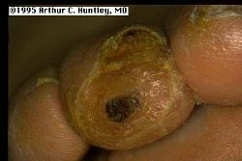
Neuro-ischaemic ulcers

Slide 66
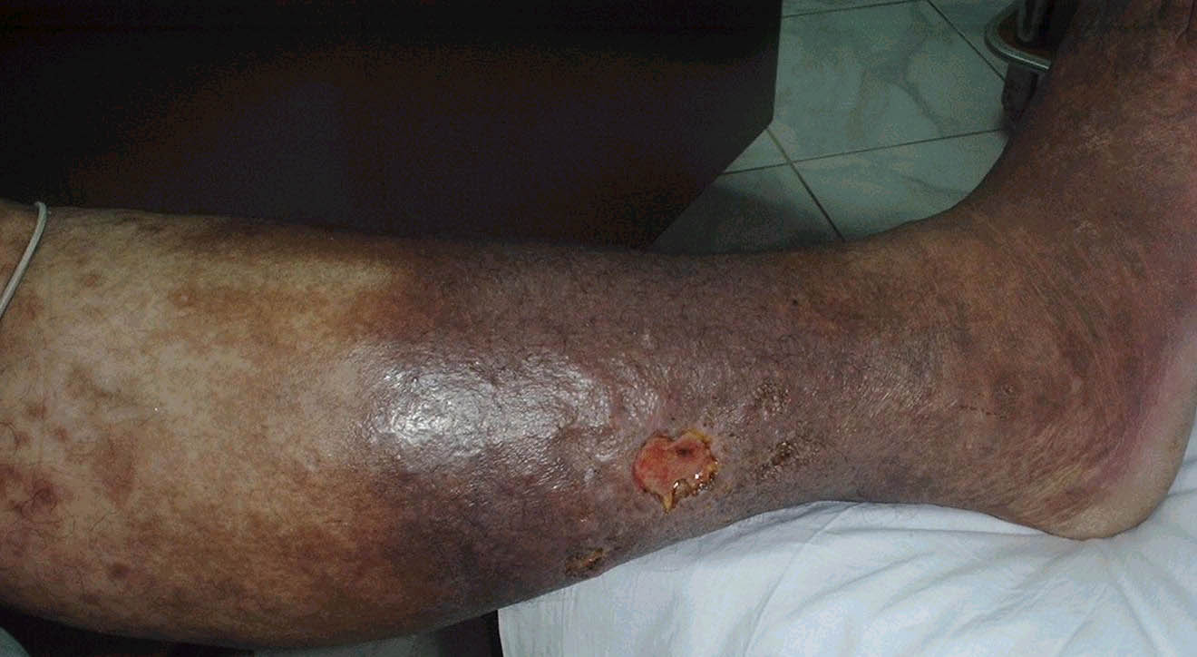
Venous stasis ulcer

Slide 67
INFECTION
Immuno-suppressed patients are most at risk
A few examples-
Diabetes
HIV
Specific drug regimes

Slide 68
INFECTION
Fungal
Tinea pedis
Onychomycosis
Risk of secondary bacterial infection
Early detection and treatment

Slide 69
Signs of infection
Redness
Heat
Pain (beware of neuropaths)
Swelling
Malodour
Lymphangitis
Lymphadenitis
Systemic effects – fever/malaise
Notes:
Lymphangitis of channels
Lymphadenitis – inflammation of nodes

Slide 70
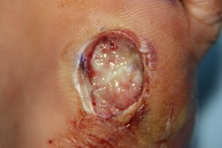
Infection in the diabetic foot
Requires immediate referral to specialist foot clinic (Who?)
85% of amputations begin with an ulcer
Infection is nearly always involved
Image From: www.leinfections.com/category/osteomyelitis/
Notes:
Who is your local diabetic specialist or contact for MDT?
Don’t know – then that is your first task for Monday morning.

Slide 71
Risk Factors in the Diabetic Foot
Previous history of amputation / ulceration
Foot deformity
Neuropathy
Vascular impairment
Reduced visual accuity
Social Factors
Notes:
----- Meeting Notes (09/05/2014 23:22) -----
But right on top as described by Boulton et al 1995

Slide 72
Relief of pressure
Non weight bearing is essential - Limitation of standing and walking - Crutches, etc. Mechanical unloading - Total contact casting/other casting techniques - Temporary footwear - Individually moulded insoles.

Slide 73
Deterioration
Be aware of your limitations as a practitioner– can you improve this patient’s condition?
Refer on

Slide 74
Multidisciplinary team
Multidisciplinary teams – GP, Podiatrist, Acute Diabetic Team, Diabetes consultant, District/Practice Nurse, vascular specialist, Orthotist, Microbiologist more……

Slide 75
Remember
The patient is an important part of healing their wounds and should be included as part of the shared care approach.

Slide 76
Diabetic snippets
High intake of protein — animal protein in particular — has been linked with an increased risk of type 2 diabetes, especially among obese women. (Diabetes Care-April 2014)
Active smokers have a 30% to 40% higher risk of developing type 2 diabetes (Medscape - April 2014)
Adults with diabetes show a significantly greater risk for serious illness related to influenza. (Diabetologia – Jan 2014)
Data from the USA indicate that 1 in 3 cases of diabetes diagnosed in those aged under 18 is now type 2 (Medscape – March 2014)
Postmenopausal women with elevated estrogen levels are at increased risk of developing dementia, and those who also have diabetes may face an even greater threat of cognitive decline. (Neurology – Jan 2014)

Slide 77
Your Practical Assessment
Neuro & Vascular assessment
10g monofilament
128 MHz vibration
Pulses (Tibialis Posterior & Dorsalis Pedis)
Palpable , Doppler utrasound
Capillary refresh rate
Proprioception
Muscle wasting
Blood pressure
Blood sugar

Slide 78
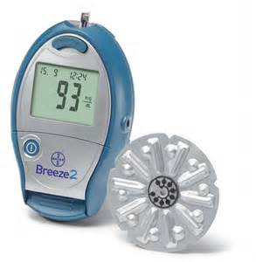
Bayer Breeze 2 Blood Glucose testing

Slide 79
Insulin pump

Slide 80
Medtronic Minimed display

Slide 81
Education
DESMOND (Diabetes Education and Self Management for Ongoing and Newly Diagnosed) – short course (6 hours) for Type 2
DAFNE (Dose Adjustment for Normal Eating) is a five-day course which focuses on using insulin properly
www.diabetes.org.uk

Slide 82
Diabetic advice
Self examination (with prompt action)
Regular professional check ups
Avoid smoking
Good foot hygiene
Good glycaemic control
Techniques for avoiding foot trauma

Slide 83
Techniques for Avoiding Foot Trauma
Do not walk bare footed
Test bath water with elbow
Do not use chemical agents (Corn plasters) to remove corns/calluses
Have shoes fitted
Inspect shoes daily for foreign objects
Do not wear shoes without stockings
Avoid hot water bottles and electric blankets
Do not sit too close to the fire
Do not wear shoes with thongs between the toes

Slide 84
The key things we see
Dry (anhydrotic) skin
Pressure areas
Hairless legs & feet
Discoloured skin
Bulging veins / varicose
Hot feet
Lack of sensation
Burning / tingling feet
Slow healing wounds
Lack of sensation

Slide 85
What do you do?
Act
Question
Treat or refer on!
There are a lot of MD teams that will help!

Slide 86
Summary
Diabetes is a silent killer!
It does affect you and your practice
You can embrace it – or ignore it
Embrace it and you win confidence & respect
You CAN affect its progress
You CAN help your patients
Recognition
Understanding
Treatment
Management

Slide 87
Questions
alanp@hsfcs.co.uk

